Slide 1
Intelligent Data Mining to Verify IKM Curriculum
ISAT/CS 344 – Intelligent Systems
Patrick Knowlan
Mark Ostrander
Chris Jackson
Rob Katich

Slide 2
Introduction
What is the current IKM curriculum?
Current technical market
Constantly changing, Recruit-A-Duke job postings
IS to search job criteria
Derive high-quality information from text.
Appearance and frequency of key words
Reference with technical/functional descriptions to reevaluate IKM course

Slide 3
Background/ Purpose
Text Mining using R
Search technology
Compare and contrasts short text strings
Define a relationship
Looks for frequent key words
Adjust IKM curriculum

Slide 4
Size and Scope
Mine data to make useful for faculty and students of the ISAT department
Future curriculums for the IKM concentration
Possibly other curriculums

Slide 5
Specifications
The R Project – statistical computing
Multiple packages
tm library
NLP
Depends on eight additional packages for functionality
Text mining to analyze recruitment data

Slide 6
Methodology
Text mining using R
Create readable file (.csv MS-DOS)
Create a corpus
Format and filter text
Search frequency of key words
Create dictionaries of appropriate terms
Compare and contrast searches
Make suggestion based on results

Slide 7
Discoveries
Capabilities
Reduces time
Organization & formatting
Frequency analysis
Term grouping / association
Limitations
Program compatibility
Mac vs. PC
Search capabilities
“C++” “C#”

Slide 8
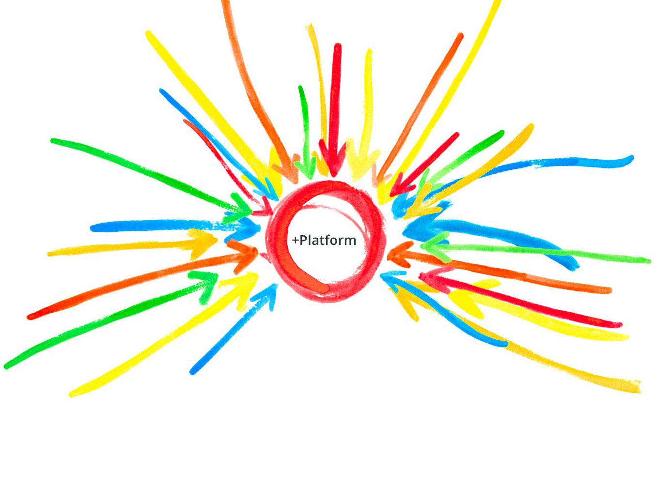
Demonstration
IKM
Curriculum

Slide 9
Results

Slide 10
Results

Slide 11
Results

Slide 12
Results

Slide 13
Conclusions
Summary
VB is OUT
JAVA is IN
Stress web technology
Web application development
Database skills
Oracle
Microsoft Office necessity
Unix systems
Business technology classes

Slide 14
Questions?

